Slide 1

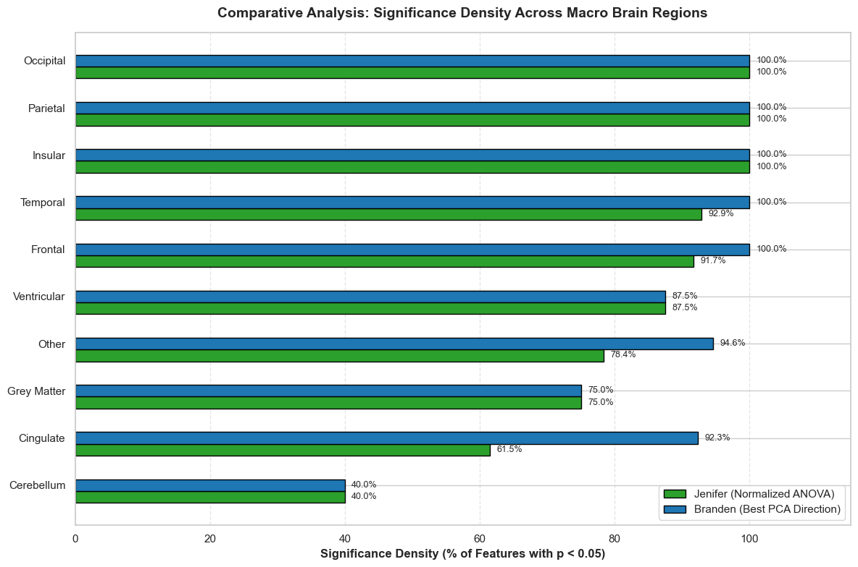
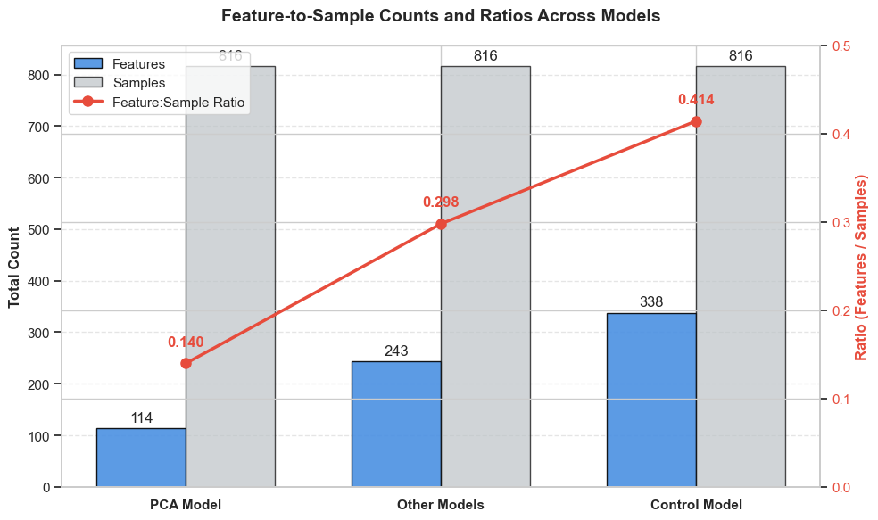
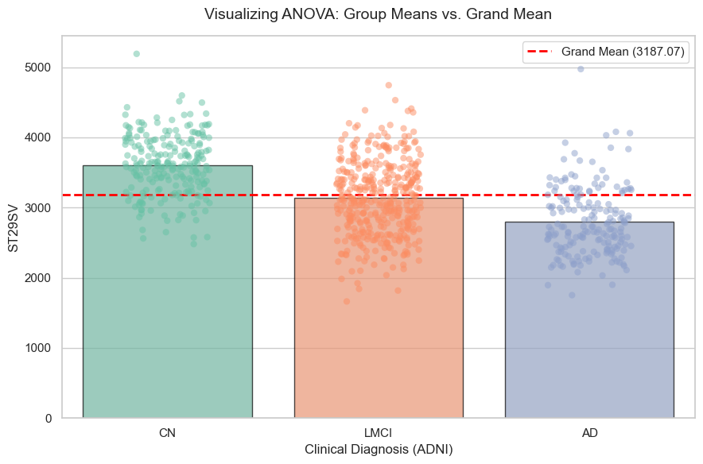
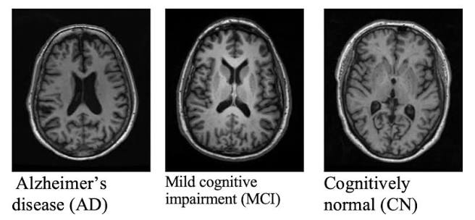
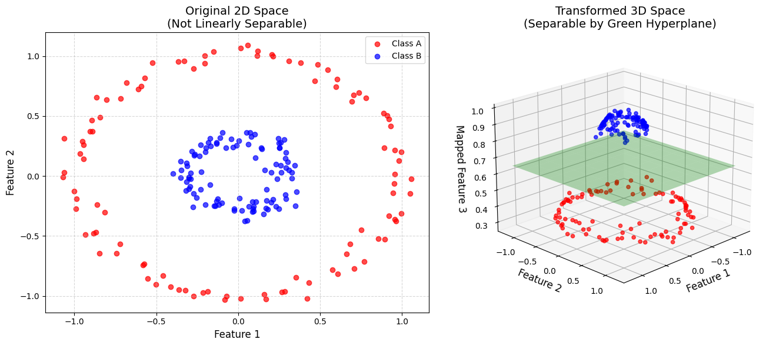
Uncovering feature significance in Alzheimer’s Disease via statistics and machine learning
Jenifer Roque-Martinez, Branden Crenshaw, UNC Charlotte
Dr. Zheming Gao, William States Lee College of Engineering, Department of Industrial and Systems Engineering
Introduction
Methodology
Results
Problem
Alzheimer’s Disease (AD) is a progressive, irreversible neurodegenerative disorder.
Early detection at the Mild Cognitive Impairment (MCI) stage is critical before irreversible structural damage occurs.
High-dimensional sMRI data contains hundreds of localized features, making it difficult to determine which ones are important for AD diagnosis.
Objective
Advance data-driven tools to find and analyze ROI features related to the detection of early Alzheimer’s Disease.
Group normalized data by cohorts
Run ANOVA on individual structural measurements
Map significant features (p < 0.05) to their macro brain regions
Compare results by dividing number of significant features retained in Best PCA model by same regions.
Model | Accuracy | Precision | Recall | F1-Score | Characteristic
Control Model | 73.00% | 74.00% | 73.00% | 73.00% | Weakest Overall
PCA Model | 82.00% | 82.00% | 82.00% | 81.00% | Most Efficient
Regional Model | 82.00% | 82.00% | 82.00% | 82.00% | Most Balanced + Best AD Recall
Individual Model | 84.00% | 85.00% | 84.00% | 84% | Best Overall
Feature Reduction Strategy (PCA)
PC_{k}= w₁(Feature₁) + w₂(Feature₂) + w₃(Feature₃) + w₄(Feature₄)
Feature₁ = ST32TA
Feature₂ = ST32TS
Feature₃ = ST32SA
Feature₄ = ST32CV
PC_{k} = ST32
Finding Weights via F-Statistic (ANOVA)
w = coefficient
k = top-k component
Data
Feature Weighting Strategy
Individual Features:
MRI data is sourced from the Alzheimer’s Disease Neuroimaging Initiative (ADNI) database with 3 cohorts:
327 distinct structural brain features were grouped into 10 macro regions:
ANOVA(Feature) = F-Statistic, P-Value
Observations::
Score = Softmax(All F-Statistics) → Scores Add Up to 1
Regional/PCA:
PCA performed noticeably weaker on AD specific recall
Recall is the ability of a model to correctly identify all true positive cases (missing an AD diagnosis is dire)
Individual weighting had a bigger impact on regional weighting than PCA did
Weighting features beyond individual weighting appeared to have no significant change in performance
ANOVA(Region) = Average F-Statistic of Region’s Features
Score = Softmax(All Averages) → Scores Add Up to 1
Weight Application During Training
SVM Model (Example)
Calculated weights based on training data only
Applied same weights to validation and testing data
Macro Region | Feature Count
Temporal Lobe | 50
Frontal Lobe | 48
Cingulate Cortex/Limbic | 37
Parietal Lobe | 32
Occipital Lobe | 24
Subcortical Deep Gray Matter | 12
Ventricular/CSF Systems | 8
Insular Cortex | 8
Cerebellum/Brainstem | 5
Other/Cortical WM Parcellations | 103
Total Features: | 327
SVM Input = (features) * (Individual/PCA weight) * (Regional weight)
Conclusions
Determined best weights by training many different SVM models
ANOVA provides a largely stable method of ranking brain regions. Regional ranking is best used as an interpretive lens when using individual weights rather than using it as a weight itself. PCA provides a solid foundation for compressing complex features but falls short in performance.
References
[1] Petersen, R. C., Aisen, P. S., Beckett, L. A., Donohue, M. C., Gamst, A. C., Harvey, D. J., ... & Jack Jr, C. R. (2010). Alzheimer's Disease Neuroimaging Initiative (ADNI): clinical characterization. Neurology, 74(3), 201-209.
[2] Nichols, B. N., Mejino, J. L., Detwiler, L. T., Nilsen, T. T., Martone, M. E., Turner, J. A., Rubin, D. L., & Brinkley, J. F. (2014). Neuroanatomical domain of the foundational model of anatomy ontology. Journal of biomedical semantics, 5(1), 1. https://doi.org/10.1186/2041-1480-5-1
[3] Structural MRI scans highlighting dataset features from page 8 are sourced from Alwuthaynani et al. (2023). The figure illustrates key characteristics used for detecting cognitive decline. Access the full paper at arxiv.org/pdf/2301.13504
Future Directions
Using regional ranking as a means to further explore important features
Finding similar compression algorithms such as PLS to reduce dimensionality
Notes:
Poster Outline:
Left Side of Poster:
Introduction:
-Alzheimer's Disease is a progressive neurodegenerative disease that has been around for decades
-No exact cause, often diagnosed after irreversible damage has occured
-Need for early detection tools while it is still in MCI stage
-CNNs have shown promise in feature extraction for images & can be combined with SVMs as a Hybrid Model for optimized early detection
Data:
-ADNI Data -> How many Scans? How much of each Class
Middle of Poster:
-Feature Extraction
-Pyramid & U-Net Structure/Diagrams
-Explain SVM (using visuals) & Then go into kernel options?
Right Side of Poster:
Results:
-Overfitting
Conclusions
References
https://pubmed.ncbi.nlm.nih.gov/36829675/

